Slide 1


ICAS: Integrated Circuit Attack Surface an Extensible Framework for Estimating the Susceptibility of IC Layouts to Additive Trojans Timothy Trippel¹, Kang G. Shin¹, Kevin B. Bush², & Matthew Hicks³
¹ University of Michigan
² MIT Lincoln Laboratory
³ Virginia Tech

Slide 2
Hardware is the Foundation!
Applications
Operating System
Hypervisor
Firmware
Hardware
Hardware flaws weaken even
formally verified software.

Slide 3

State of Systems Security
Software security community has developed mechanisms to both identify and prevent vulnerabilities/attacks
Attackers are forced to lower levels → hardware
Economic forces make developing secure hardware challenging
Applications
Operating System
Hypervisor
Firmware
Hardware
Symbolic Execution
Fuzzing
DEP
ASLR
TXT
KASLR
Secure Boot

Slide 4



Hardware Development Process
RTL Design
(Behavioral)
Synthesis
(Structural)
Place-&-Route
(Physical)
Fabrication
Packaging
3rd Party IP
Verification
Verification
Verification
Verification
$$$
$
$$
$$
$$$$
$$$
HDL
HDL
HDL
GDSII
Silicon Die

Slide 5
Outsourcing Reduces Trust
RTL Design
(Behavioral)
Synthesis
(Structural)
Place-&-Route
(Physical)
Fabrication
Packaging
3rd Party IP
Verification
Verification
Verification
Verification
$$$
$
$$
$$
$$$$
$$$
HDL
HDL
HDL
GDSII
Silicon Die
How do we know our designs won’t be modified to include a backdoor, or a hardware Trojan?
= Trusted
= Untrusted

Slide 6

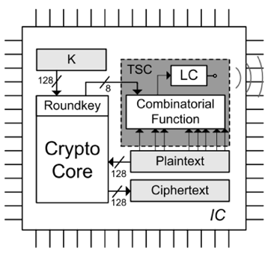


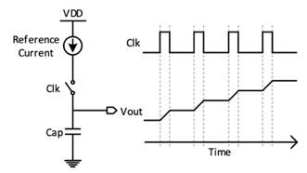

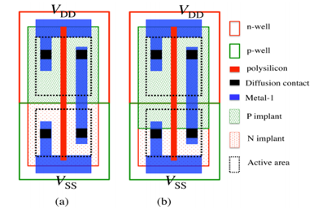
Hardware Flaws
Bugs
Trojans
PTE Inversion, L1D Flush
TSCs [Lin et al.]
Hardware
Foothold
KPTI
A2 [Yang et al.]
Unintentional
Intentional
Retpoline, IBRS, STIBP, IBPB
Parametric [Kumar et al.]

Slide 7
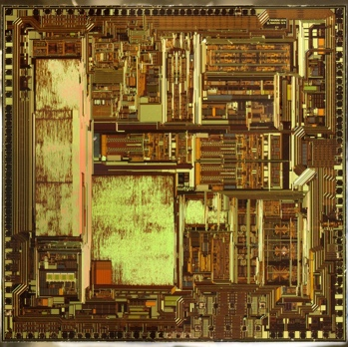
Untrusted Foundry Defenses
1. Visual Inspection
2. Side-Channel
3. Functional Testing
Prevention
Detection
Logic Locking
Split Manufacturing
SAT Attacks
Scalability
Proximity Attacks
Fabrication
Small Trojans
Layout Filling
Small Trojans
Complex Triggers
Kerckhoffs’s 2nd Principle

Slide 8

Problem
Should we care about the threat of hardware Trojans?
Why are current preventative defenses ineffective?

Slide 9

Solution
We NEED insight!
What makes a circuit layout amenable to attack?
Why are preventative defenses inadequate?
How are IC layouts constructed?
How does one insert a Trojan into a layout?
ICAS: IC Attack Surface

Slide 10
Integrated Circuit Construction
Photo from: https://www.extremetech.com/computing/
277870-intel-issues-update-on-supply-problems-at-14nm
Side View
Top View
a
Silicon Wafer
a
Metal Layer
Intel 14nm Broadwell Metal Layers
Photo from: https://www.extremetech.com/computing/193200-intels-14nm-
broadwell-chip-reverse-engineered-reveals-impressive-finfets-13-layer-design
Dielectric
Metal Layer
a
Dielectric
Device Layer
Circuit Die
a
Density: 60-80%
45nm Intel Xeon X7550
Photo from: https://hardforum.com/
threads/intel-xeon-processor-x7550-hi-res-macro-of-cpu.1969063/
Device Layer Floorplan

Slide 11
How are Hardware Trojans Inserted?
Type | Size (# additional gates/wires) | Stealth | Controllability
Additive | > 0 | High | High
Substitution | 0 | Medium | Low
Subtractive | < 0 | Medium | Low
aå
Metal Layer
Dielectric
Metal Layer
a
Dielectric
Device Layer
Trigger-Space
Net Blockage
Route Distance
1. Trojan Placement
Locate empty placement sites on the device layer for Trojan components.
2. Trojan/Victim Integration
Locate unblocked security-critical wire to connect Trojan to/near.
3. Intra-Trojan Routing
Route Trojan Trigger/Payload
to integration point.

Slide 12
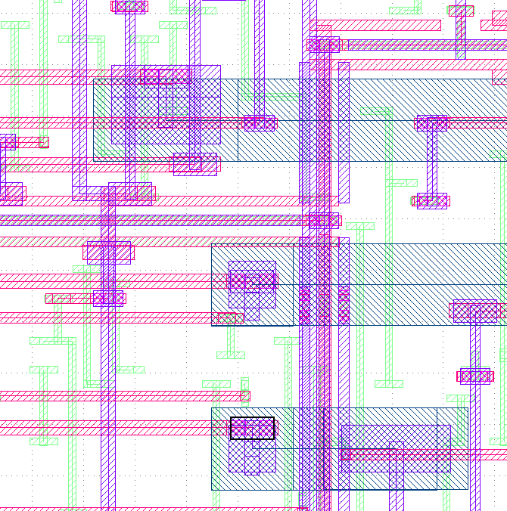

ICAS: Integrated Circuit Attack Surface
ICAS estimates the susceptibility of an IC layout to Additive Trojan insertion
Nemo – helps identify nets that influence security-critical nets
GDS2-Score – computes metrics
Trigger-Space → Trojan Placement
Net-Blockage → Victim/Trojan Integration
Route-Distance → Intra-Trojan Routing
ICAS
Netlist
Nemo
Fabrication
GDSII
GDS2-Score
Physical Layout
Front-End
Design
Front-End
Design
Security Metrics

Slide 13
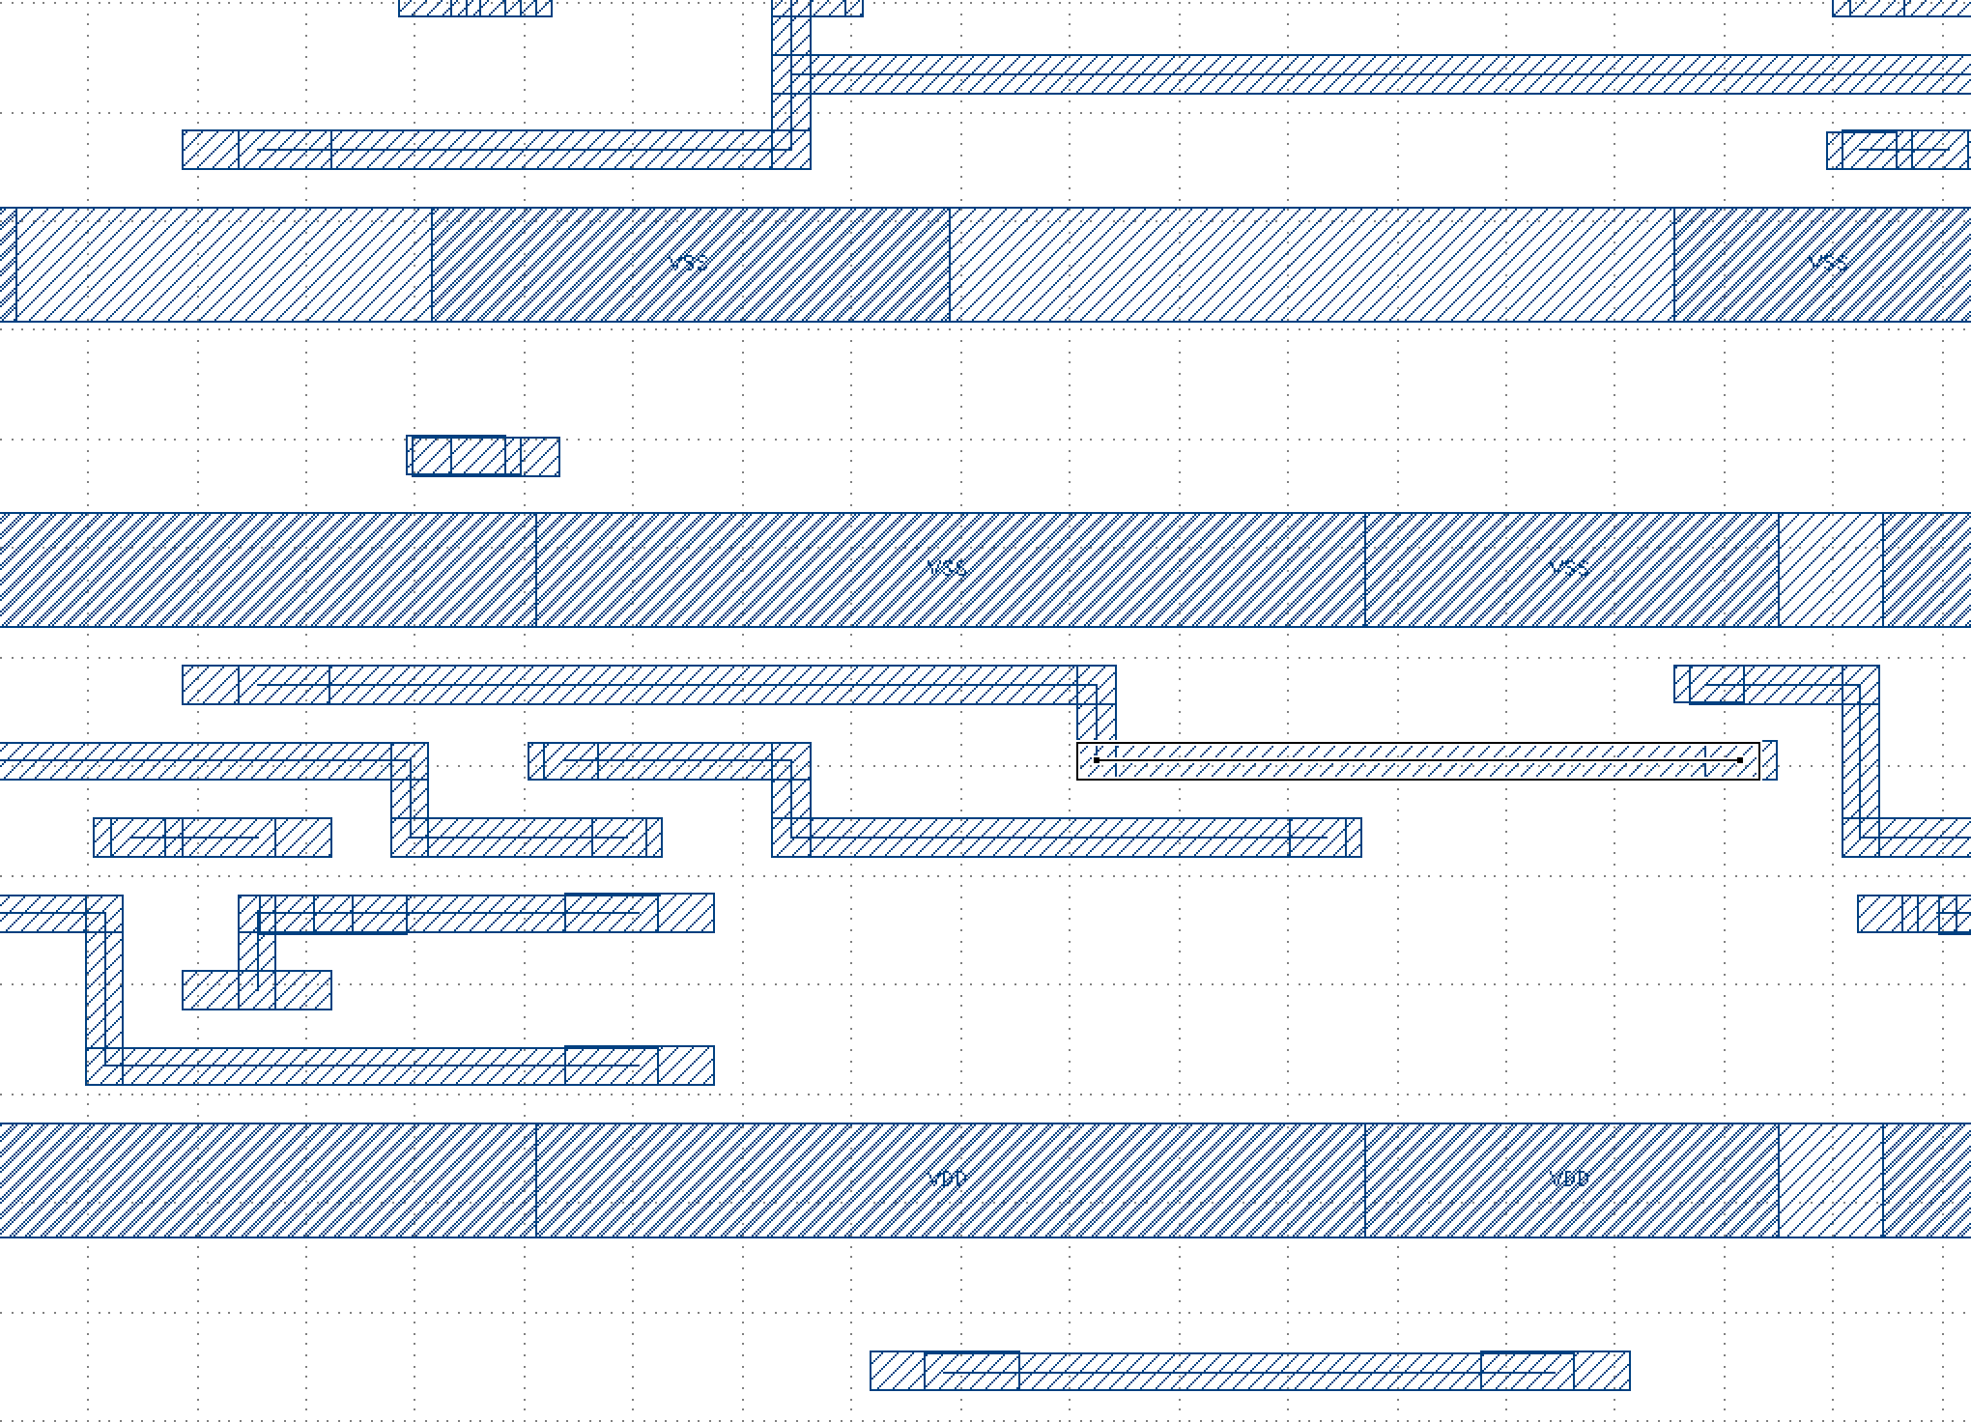
ICAS Metrics
OR1200 Processor
a
= Unused Placement/Routing Resources
= Security-Critical Wire
Trigger-Space
Net Blockage
Route Distance
Attack Surface
&
→
Unblocked

Slide 14
Justification for Metrics
Encapsulates the majority of additive hardware Trojans demonstrated
Add Transistors
Add Wires
Add Both
Metrics are flexible and can be interpreted:
Individually
Comprehensively
Additive (Layout-Level) Trojans
Design Type?
Standalone
Integrated
Add Transistors?
Add Transistors?
No
Yes
No
Yes
Parasitic Wire
RD
Parasitic Circuit
TS, RD
Short-Circuit
NB, RD
Functional
TS, NB, RD
TS = Trigger Space; NB = Net Blockage; RD = Route Distance

Slide 15
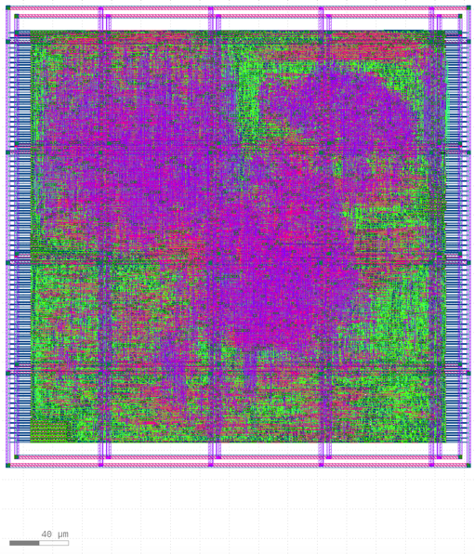
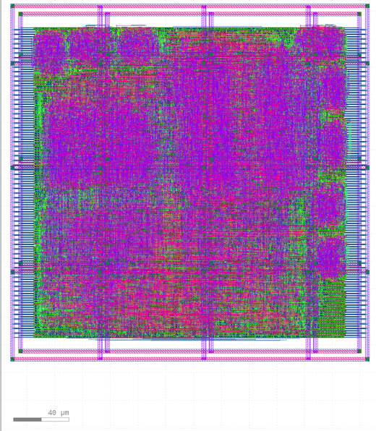
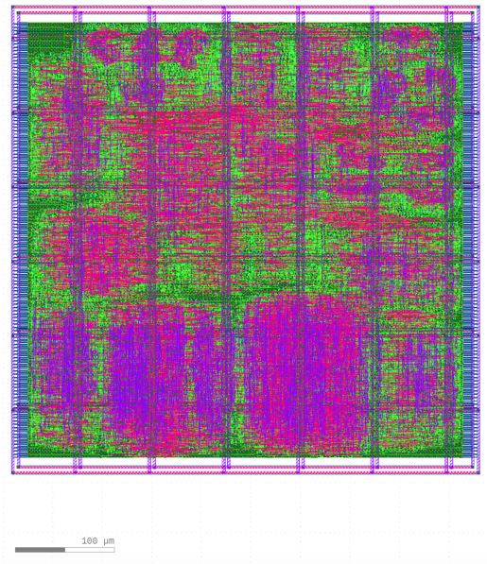
Evaluation
Uncover the effectiveness of existing layout-level defenses
Undirected
Directed
Demonstrate ICAS metrics show where IC layouts are most vulnerable to specific attacks
Study 60+ IC layouts
Three open-source cores:
OR1200 Processor
AES Accelerator
DSP Accelerator
IBM 45nm FDSOI process
Cadence Genus – Synthesis
Cadence Innovus – Layout
OR1200
AES
DSP
supv
key
next_out

Slide 16
Preventive Layout-Level Defenses
Undirected – tune layout parameters to probabilistically constrict placement & routing resource utilization [Xiao et al HOST’13]
Directed – constrict resource utilization around security-critical wires [Ba et al. ISVLSI’16]
Hardware Trojans from the Literature
Trojan Designs | # Gates | # Placement Sites | Timing Critical? (Route Distance Constrained?)
A2 Analog [Yang et al. S&P’16] | 2 | 20 | No
A2 Digital [Yang et al. S&P’16] | 91 | 1444 | Yes
Privilege Escalation [Hicks et al. S&P’10] | 25 | 342 | Yes
Key Leak [Salmani et al. ICCD’13] | 187 | 2553 | Yes

Slide 17
Attack Surface with Undirected Defense
Undirected Layout Defenses
Constrict placement resources
Core density [Xiao et al. HOST’13]
Constrict routing resources
Maximum transition time
Deployed on OR1200 only
Route Distance plot shows Attack Surface
Each heatmap represents an IC layout
Each heatmap column is a histogram
Each color-coded rectangle indicates the resources required to implement an attack
Thousands of attack configurations still possible!
*Clock frequency held at 1 GHz across all layouts

Slide 18
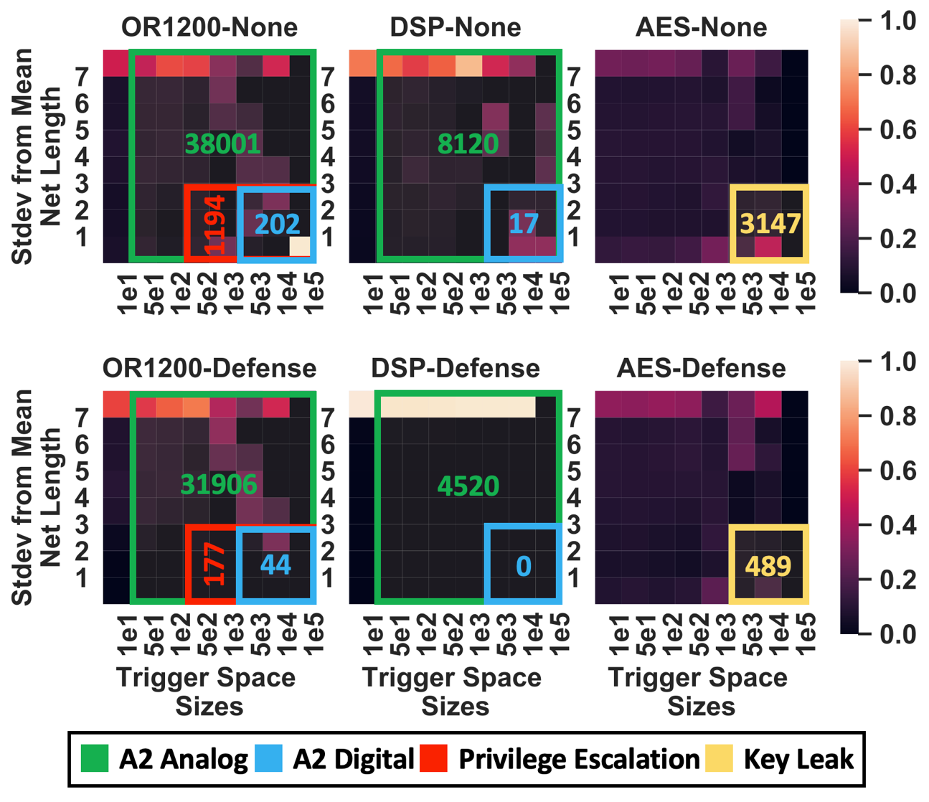
Attack Surface with Directed Defense
Directed Layout Defense
Constricting resources nearest security-critical wires
Directed layout filling defense (up to 95% total density)
Deployed on all designs with the same layout parameters across each
Route Distance Plot shows Attack Surface
Thousands of attack configurations still possible!
[Ba et al. ISVLSI’16]

Slide 19
Conclusion
Modern IC layouts leave a plethora of placement/routing resources for foundry-side attackers to exploit
Preventative defenses against foundry-level attacks are placement focused and inadequate against small Trojans, like A2
What about routing centric defenses?
ICAS aim to make security a first-class concern alongside power, performance, & area

Slide 20
Questions?
trippel@umich.edu
https://timothytrippel.com
ICAS Repositories:
https://github.com/mit-ll/nemo
https://github.com/mit-ll/gds2-score
DISTRIBUTION STATEMENT A. Approved for public release. Distribution is unlimited. This material is based upon work supported by the Under Secretary of Defense for Research and Engineering under Air Force Contract No. FA8702-15-D-0001. Any opinions, findings, conclusions or recommendations expressed in this material are those of the author(s) and do not necessarily reflect the views of the Under Secretary of Defense for Research and Engineering.
This material is based upon work supported by the National Science Foundation Graduate Research Fellowship Program under Grant No. DGE 1256260. Any opinions, findings, and conclusions or recommendations expressed in this material are those of the author(s) and do not necessarily reflect the views of the National Science Foundation.

